Slide 1


The King is Dead Long live the King?

Slide 2
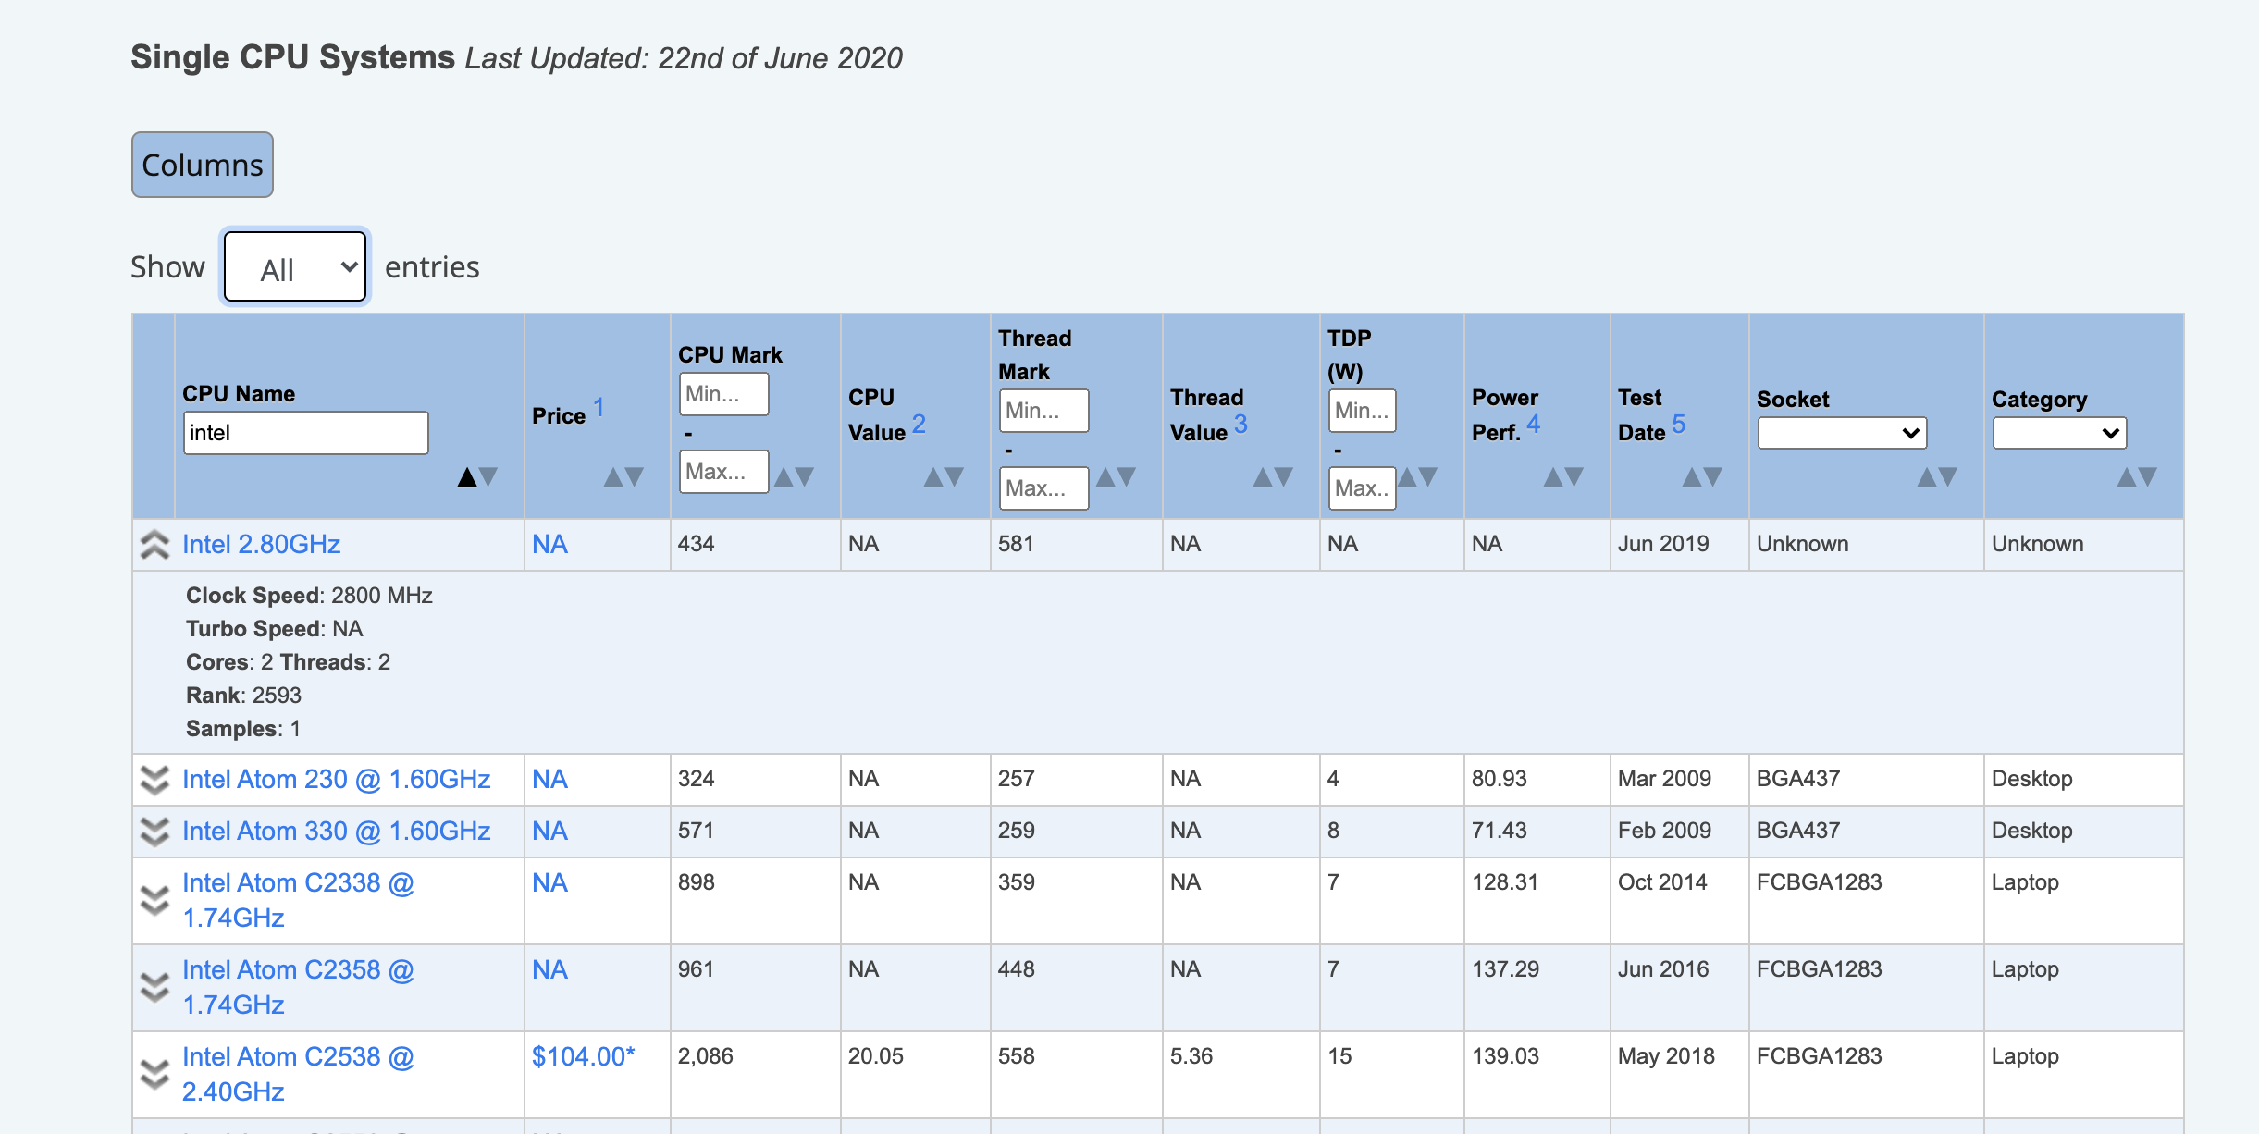
PassMark Software – CPU Benchmarks

Slide 3
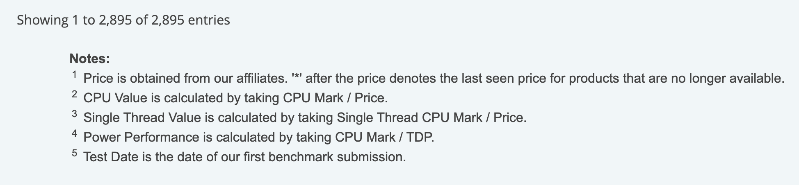
https://www.cpubenchmark.net/CPU_mega_page.html

Slide 4
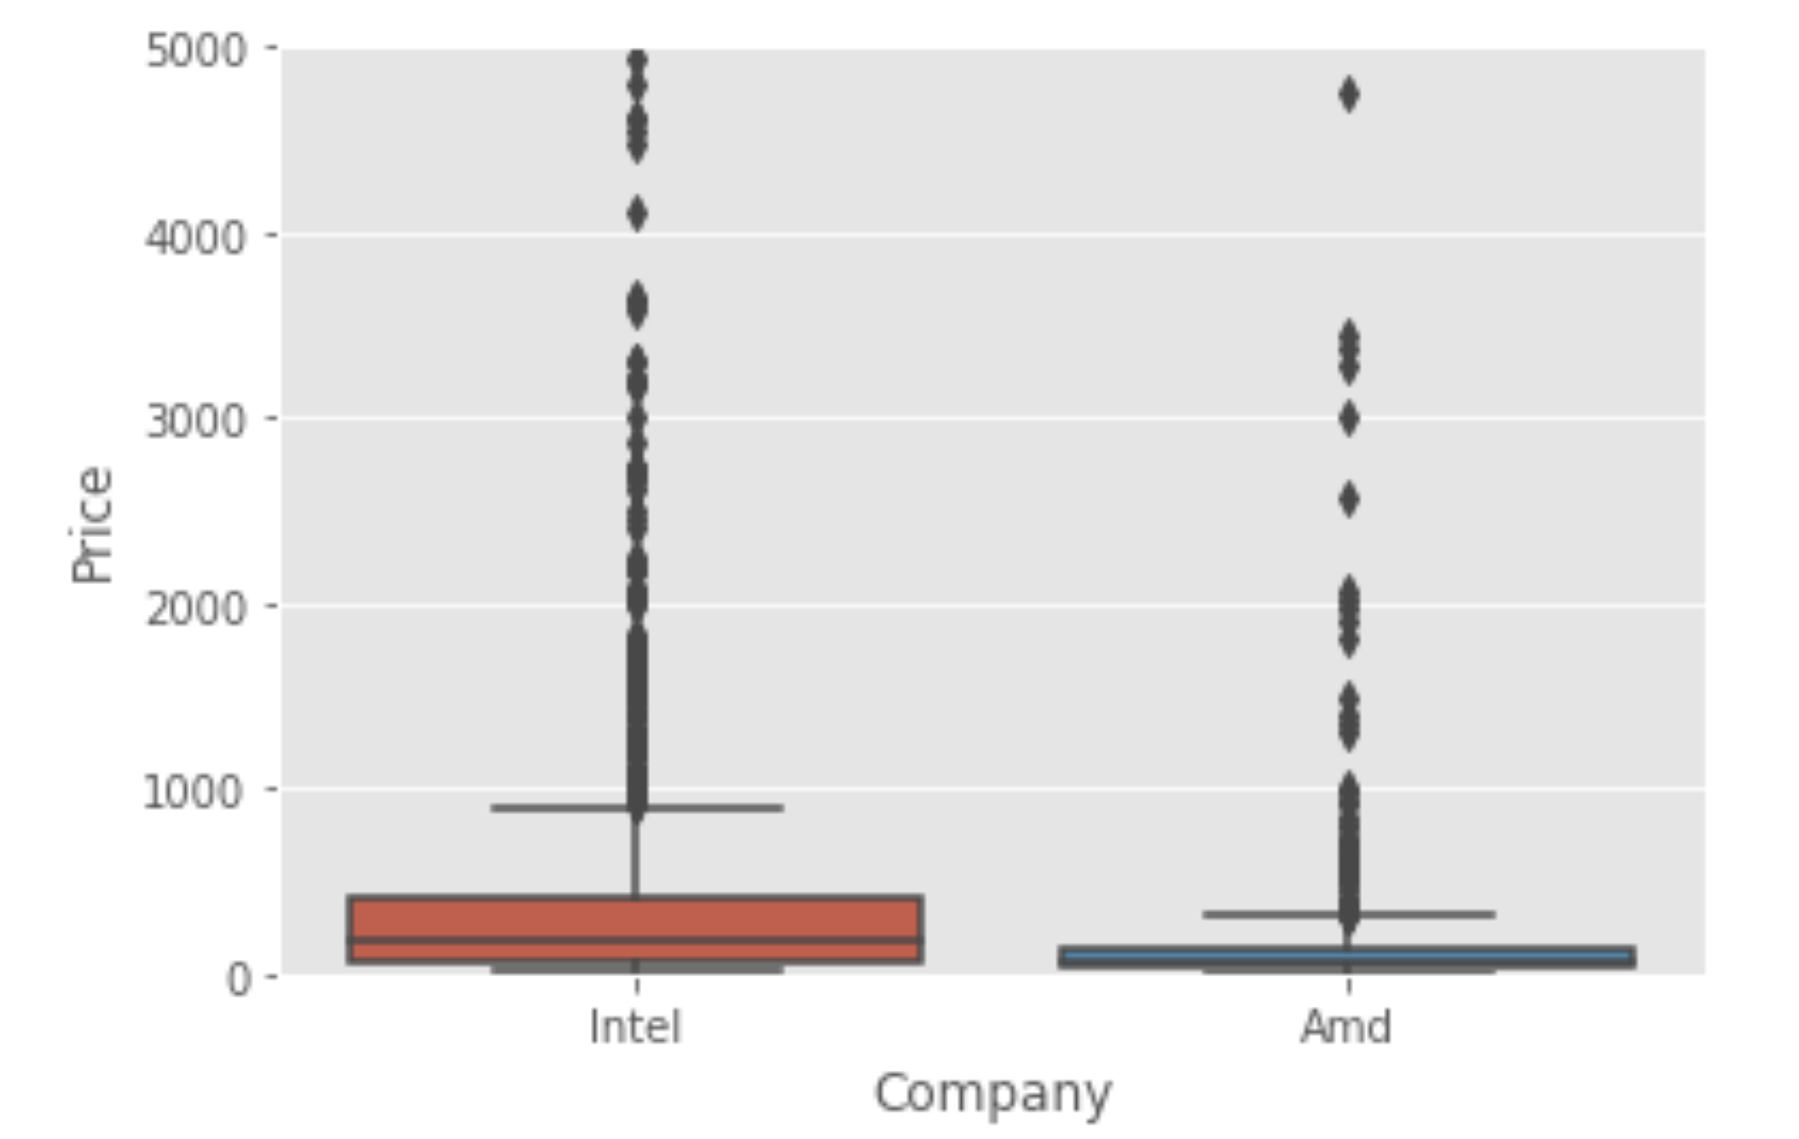
Budget King - AMD

Slide 5
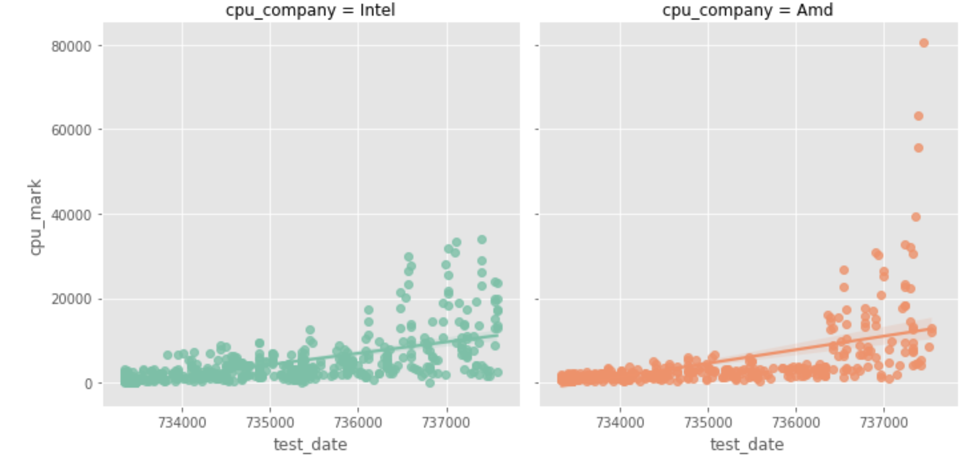
CPU Mark - Desktop

Slide 6
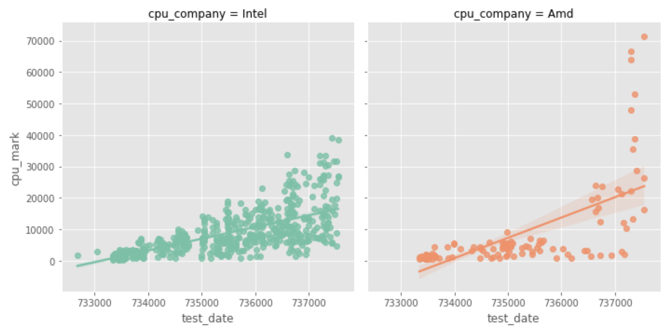
CPU Mark - Server

Slide 7
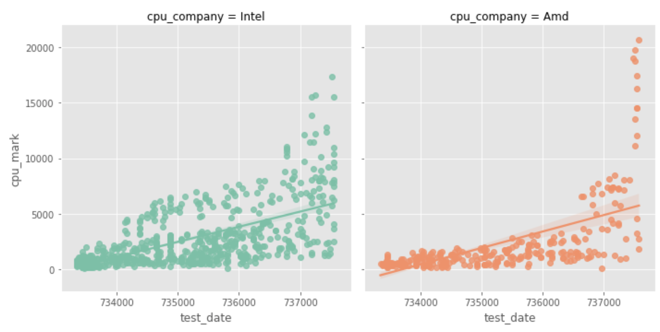
CPU Mark - Laptop

Slide 8
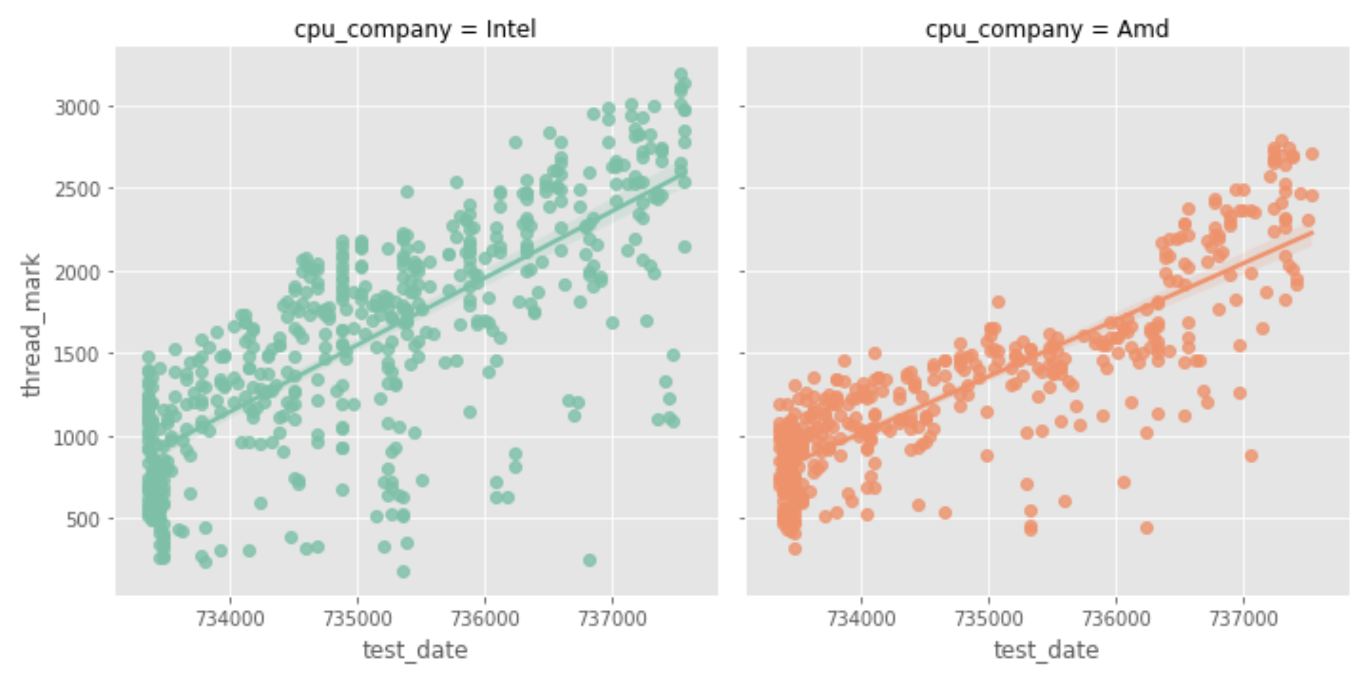
Single Thread CPU Mark - Desktop

Slide 9
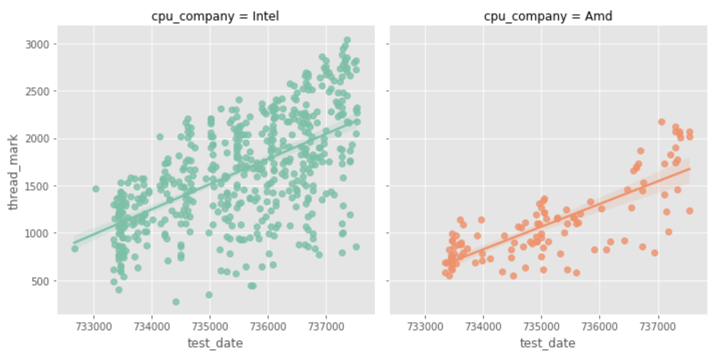
Single Thread CPU Mark- Server

Slide 10
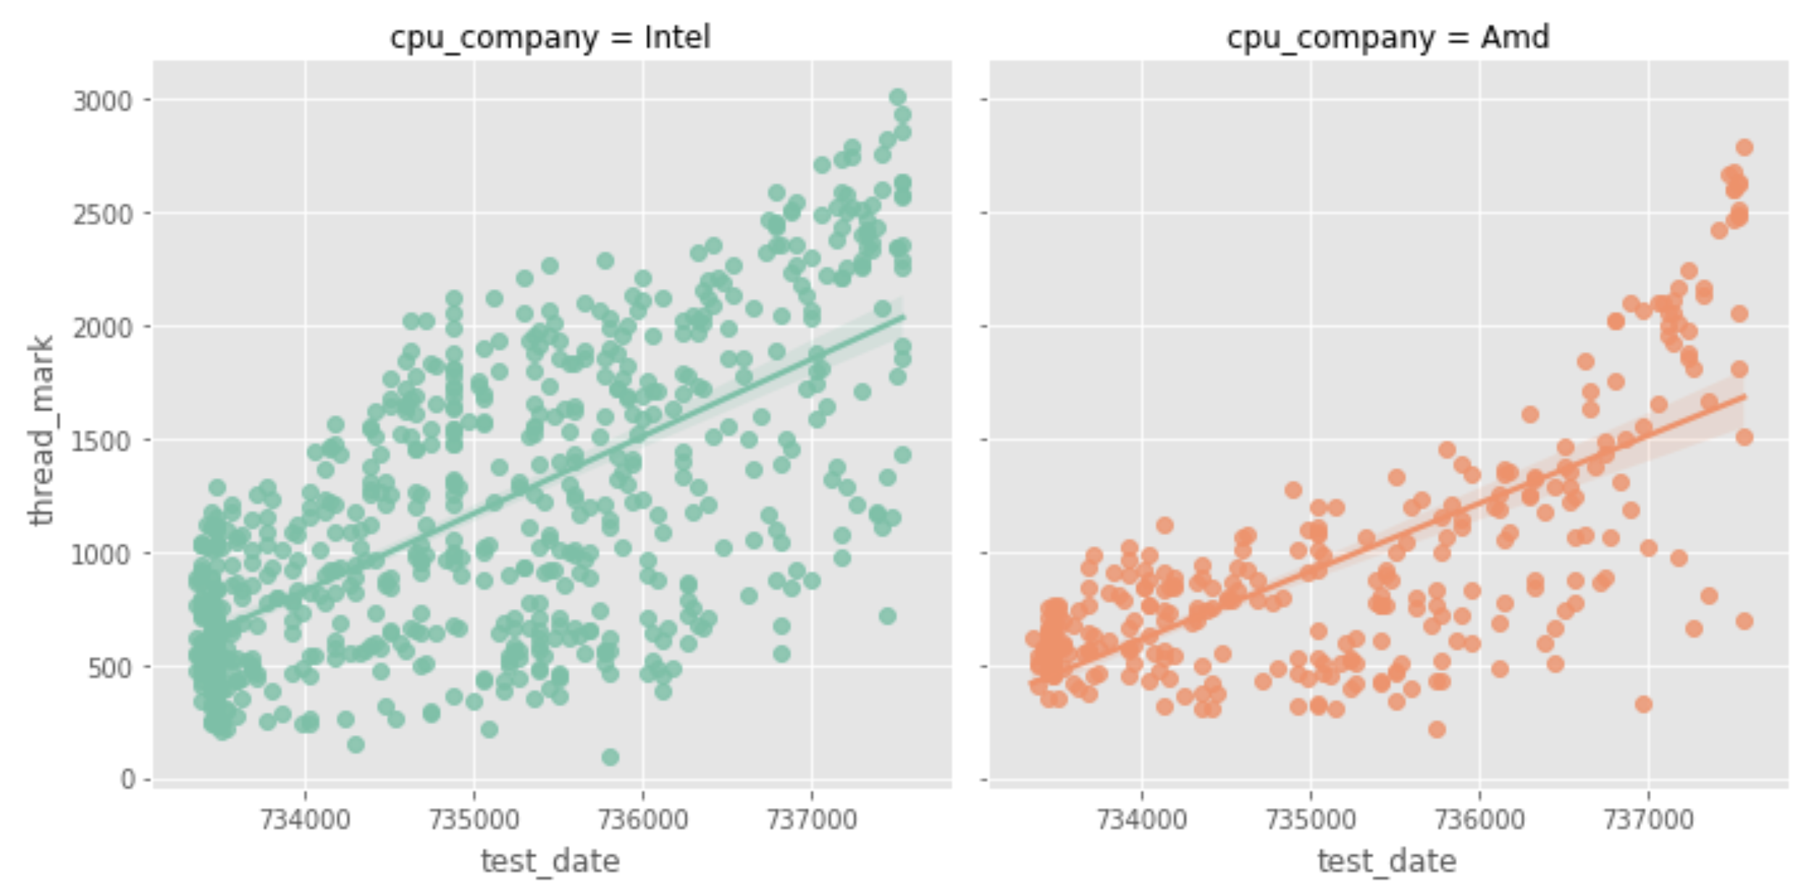
Single Thread CPU Mark- Laptop

Slide 11
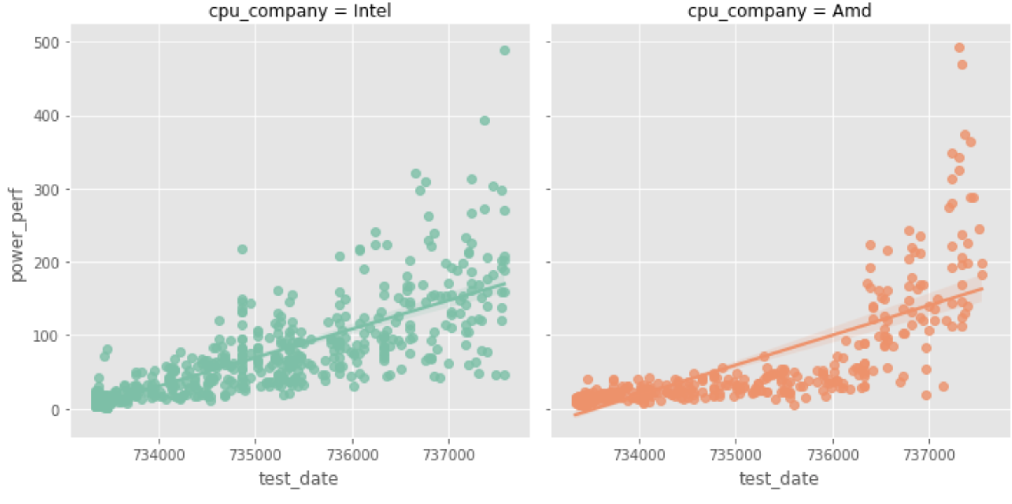
Power Performance - Desktop

Slide 12
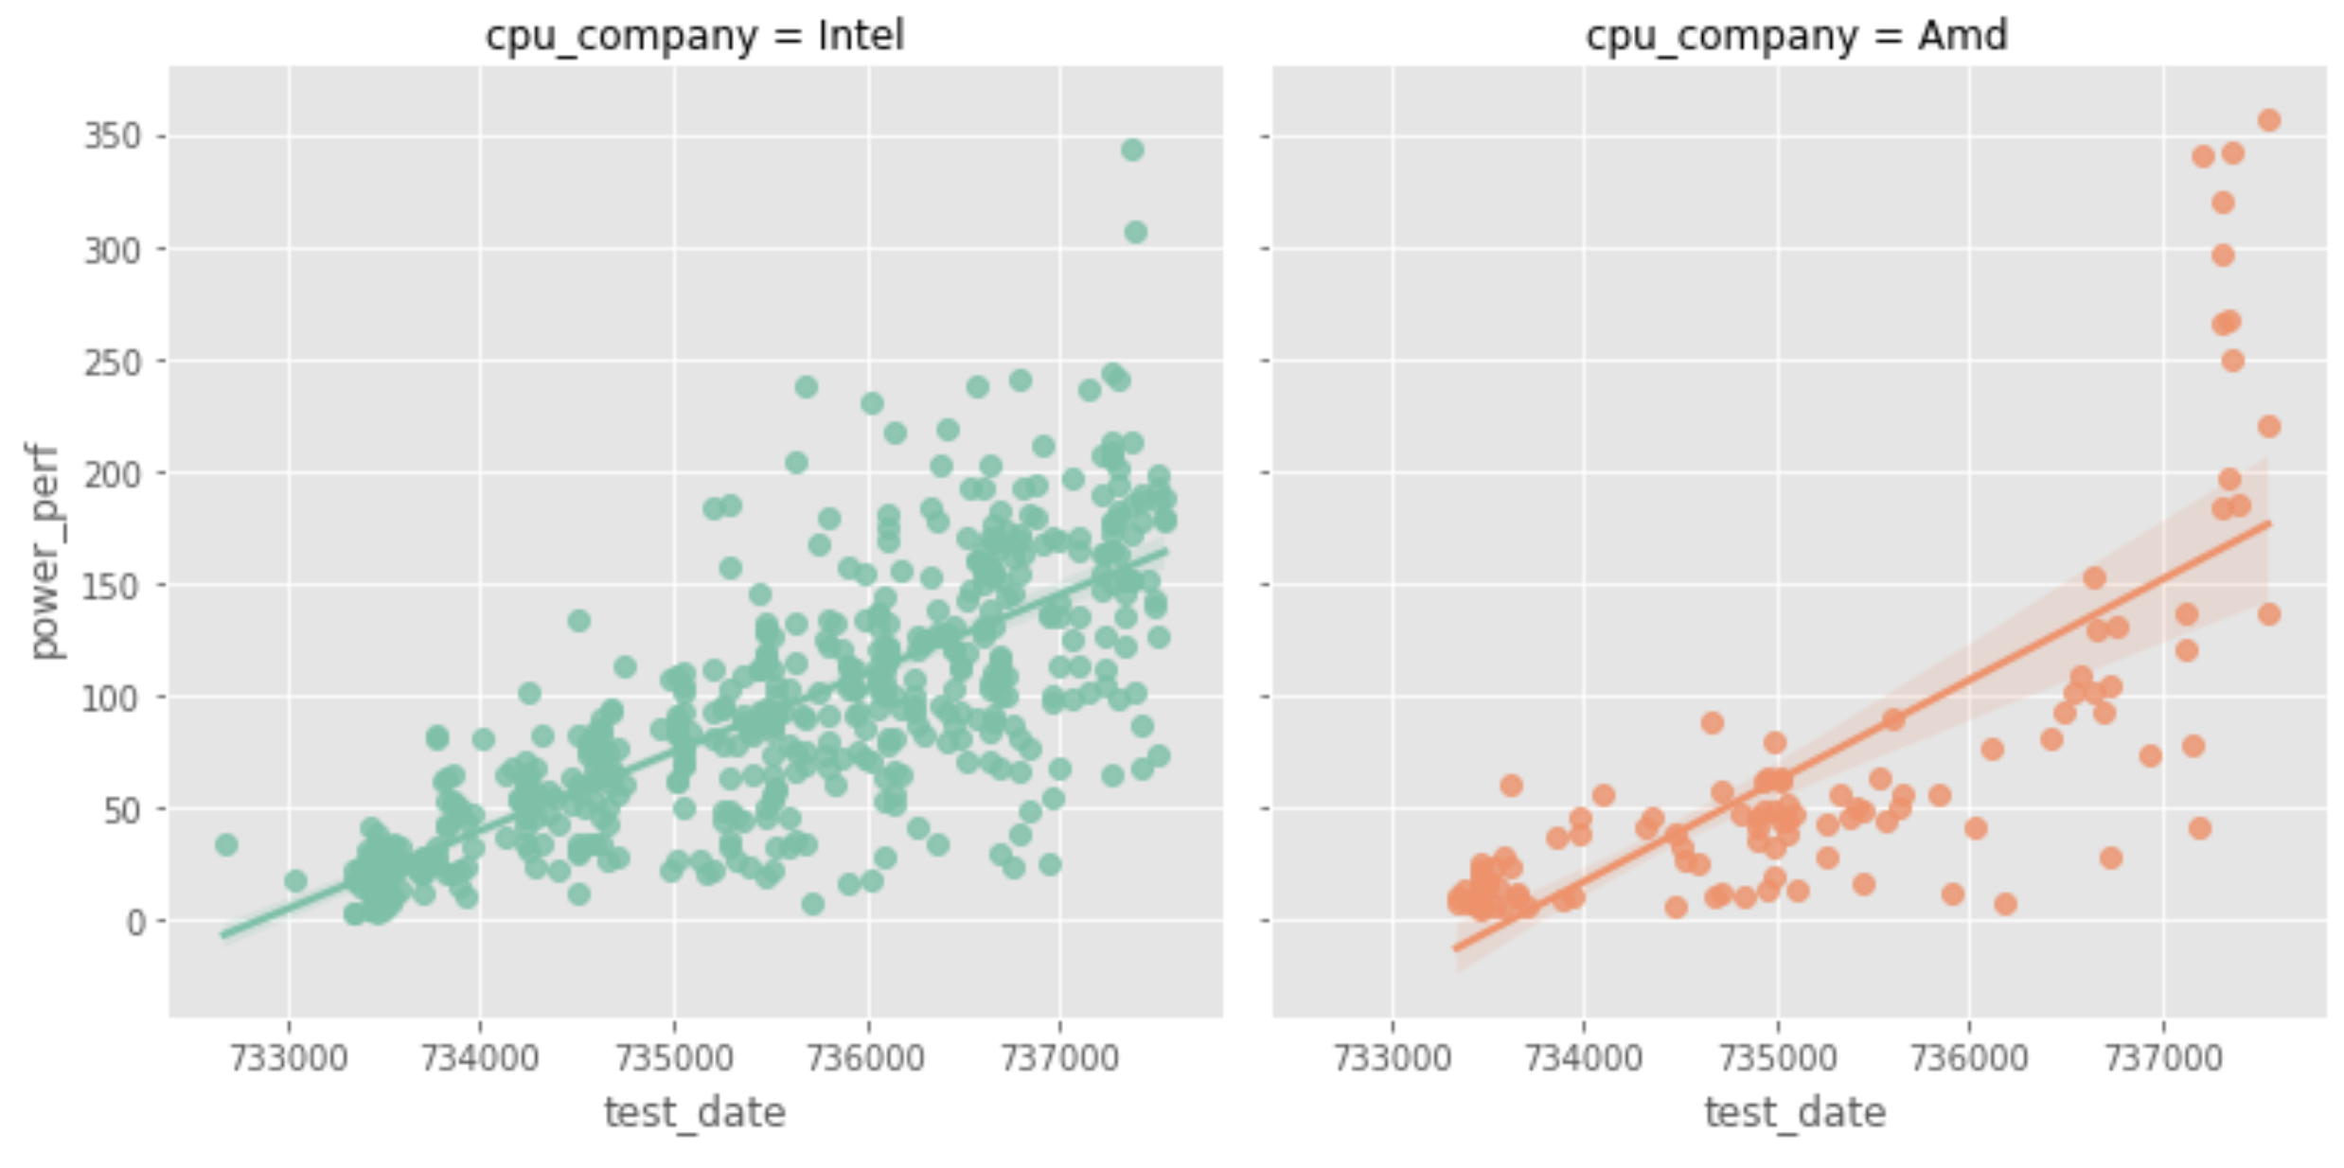
Power Performance - Server

Slide 13
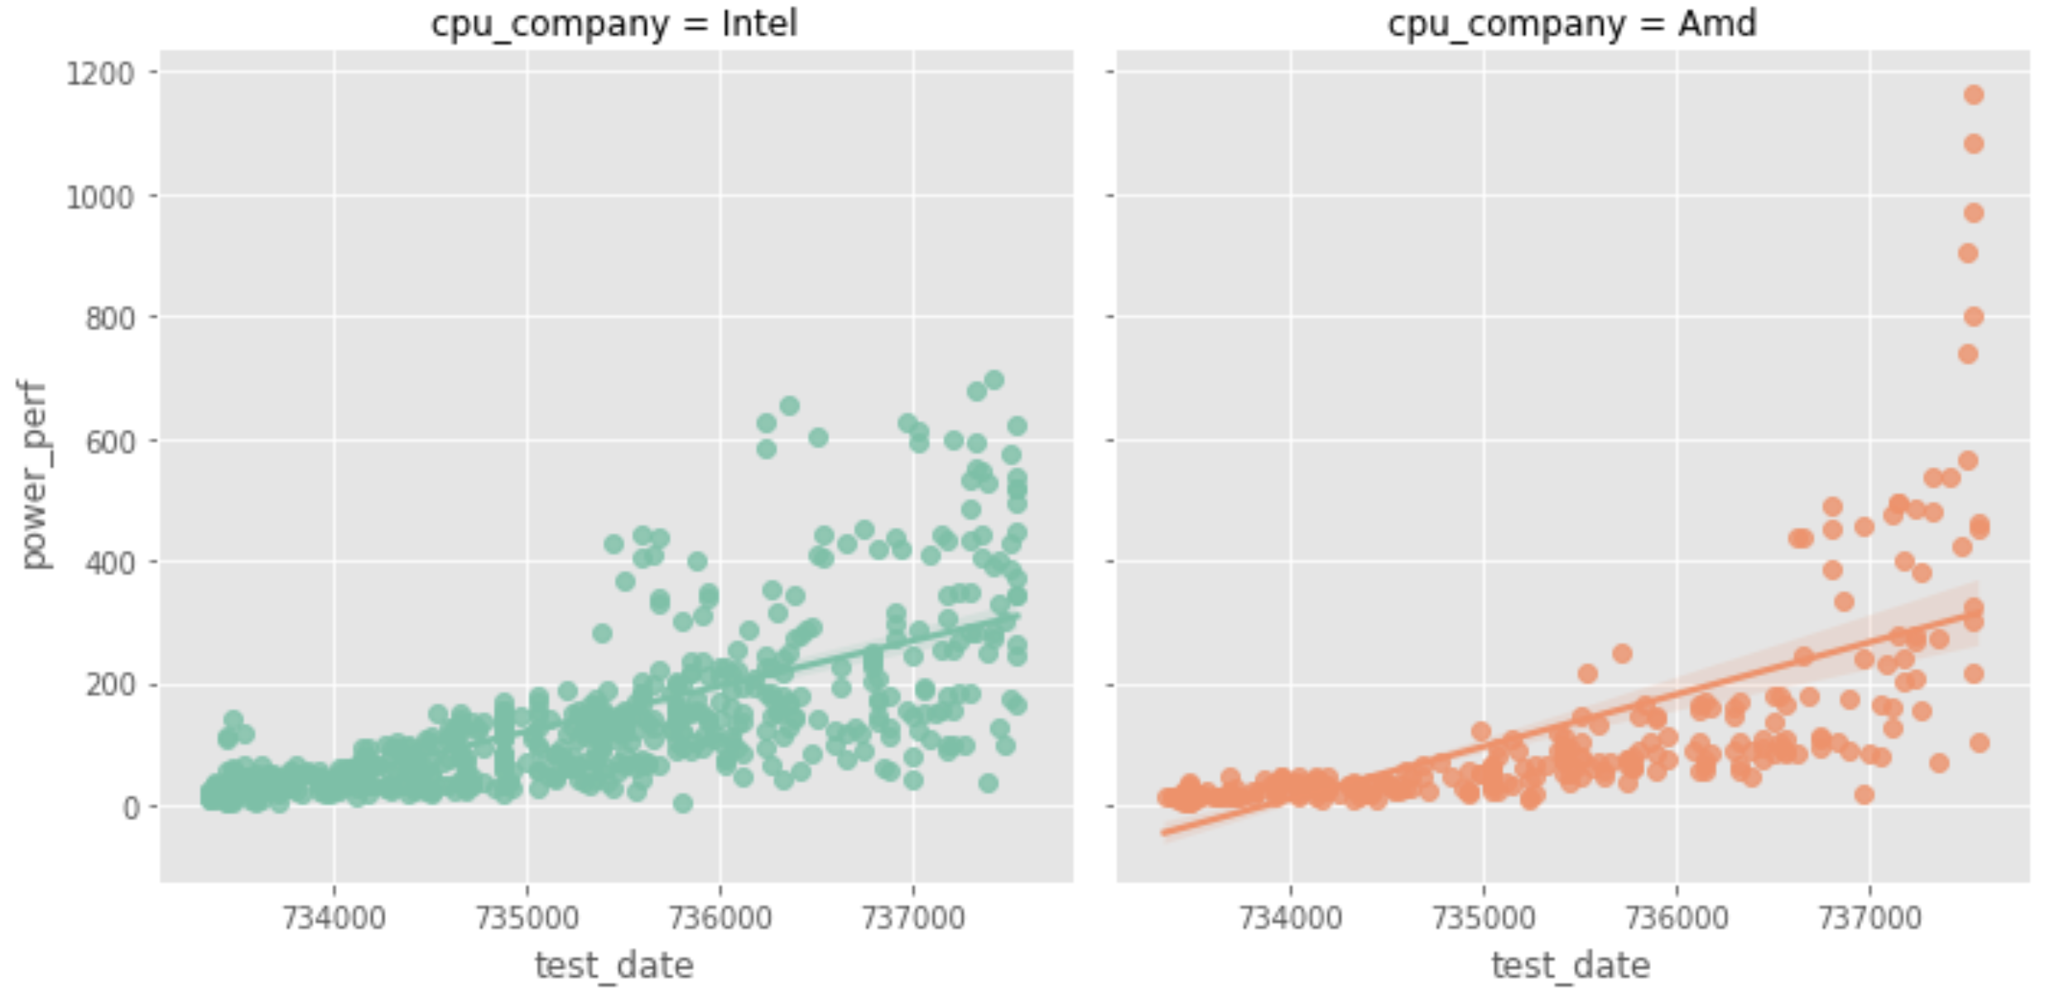
Power Performance - Laptop

Slide 14
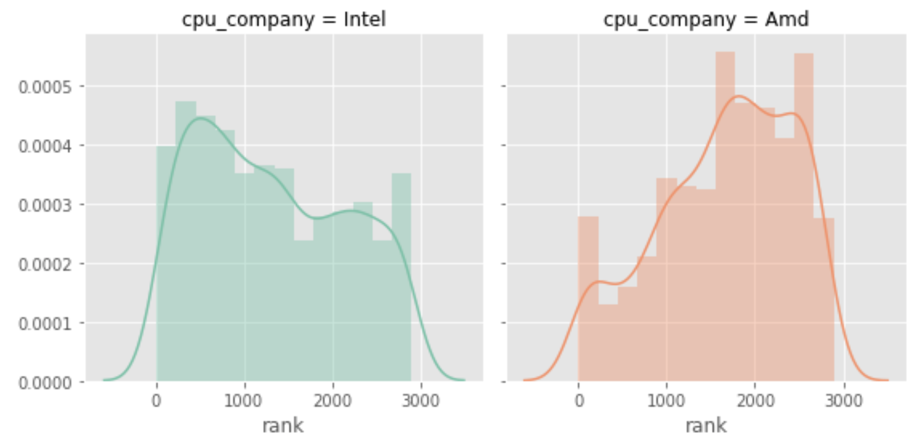
Rank Distribution

Slide 15
AMD has certainly RYZEN back in an EPYC manner Hopefully it will keep RYZEing!!!

